Slide 1
SERVICE MANAGEMENT SYSTEM - LOGISTICS
FRIDALYN T. LESIGUES
Presenter
Marc Julius M. Barcinal
Eunique Lambert L. Malang
Ronalyn M. Ramos
Romel B. Cabiling
Members

Slide 2
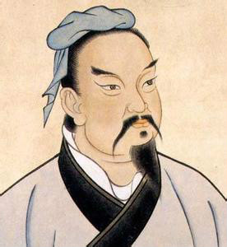
INTRODUCTION
“The line between disorder and order lies in logistics”
-Sun Tzu, (The Thirty-Six Stratagems)

Slide 3
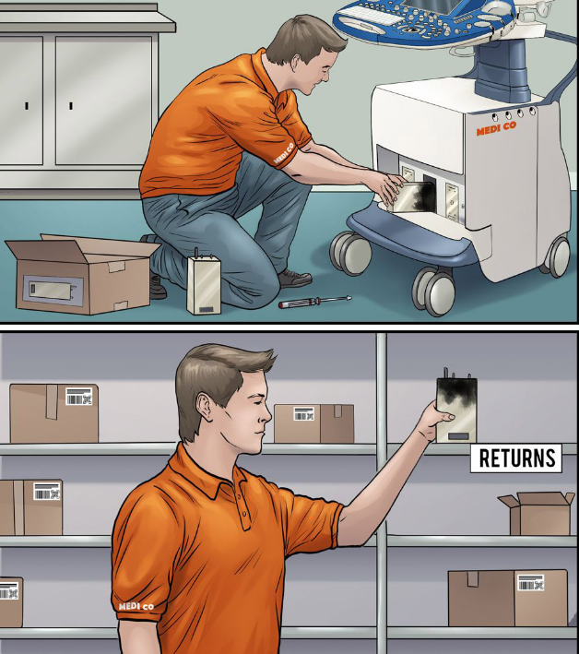
INTRODUCTION
Problem
The management of logistics here in the Philippines is still being processed manually according to the latest white paper published by YCP Solidiance titled “Digitalization in the Philippine Logistics Industry.
https://www.warehouseanywhere.com/resources/45-things-about-reverse-logistics/

Slide 4
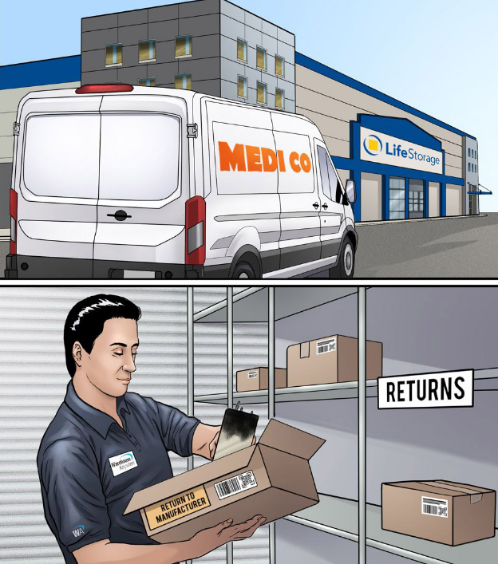
INTRODUCTION
Problems
Misplacement or Lost of records.
Unreliability of documents.
Absence of backup files in case of disasters.
Inefficiency of workload.
Waste of time.
https://www.warehouseanywhere.com/resources/45-things-about-reverse-logistics/

Slide 5

INTRODUCTION
Tech-Trendz Services
Service Management System
The proponents propose the development of Tech-Trendz Services, a web-based service management system that features a centralized network all across every departments in a company. This system solves the key problems about data security and data integrity because a centralized network is built around a single server that handles every major process in the system.

Slide 6
INTRODUCTION
Tech-Trendz Services
Service Management System
Assurance of Data Security and Data Integrity.
Generation of reports and requests using forms.
Digitalized monitoring of assets.
An accurate audit trail.
Sort and Search function for quick organization of records.
Real-time notification function.

Slide 7
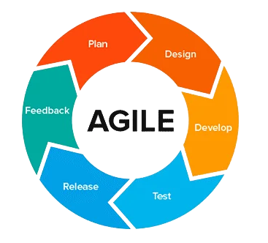
METHODS
AGILE METHODOLOGY
Productivity - Around 55% of their respondents listed that the reason they use this methodology is that they achieved increased productivity in their work.
Manage changes - The advantage of managing the change of priorities was listed by 64%, and it is one of the most popular ones.
Software delivery - An impressive 75% of the respondents listed accelerated software distribution as their most significant reason to use Agile.
Distributed teams - Last but not least, 17% of their respondents listed that the reason they chose Agile is to get better at managing the distributed teams.
Source: https://updatedideas.com/agile-methodology/

Slide 8
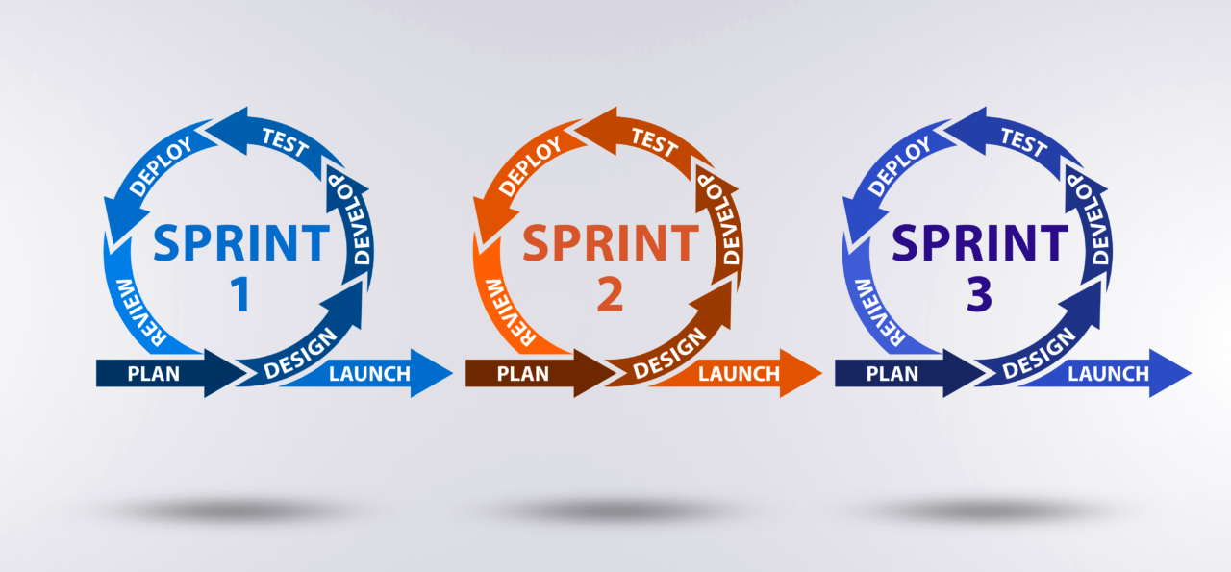
METHODS
Source: https://kruschecompany.com/agile-software-development/

Slide 9
SERVICE MANAGEMENT SYSTEM - LOGISTICS
FRIDALYN T. LESIGUES
Presenter
Marc Julius M. Barcinal
Eunique Lambert L. Malang
Ronalyn M. Ramos
Romel B. Cabiling
Members

Slide 10

3rd SIMP - AAG – BCP MULTIDISCIPLINARY
RESEARCH FESTIVAL
Virtual Conference

